Slide 1

Part 4
Q and A Panel
30 mins
Notes:
Speaker: Asir

Slide 2
Azure Spring Apps Enterprise
Ship faster with VMware Tanzu components
Unlock Spring’s full potential with VMware Spring Runtime Support
Notes:
Azure Spring Apps has 3 tiers – Basic, Standard, and Enterprise.
Enterprise is the new tier and is generally available.
Enterprise delivers even more productivity, and you can leverage Spring experts to make your projects even more successful.
[Message]
There are three tier of Azure Spring Apps.
Recap the three tiers.
Why and when should I use the Enterprise tier?
You get access to Tanzu features:
Tanzu Build Service enables you to deploy polyglot apps to Azure Spring Apps.
Spring Apps Gateway with Commercial-only features save you time and effort.
API Portal.
Extended support for Spring OSS.
With more features coming …

Slide 3
Ship faster with VMware Tanzu components
Buildpacks with app integrations
Management of app container creation
Out-of-the-box SSO with any identity provider
Out-of-the-box throttling and caching
Accelerators for hardening app config and best practices
Cloud-native streaming and batch data processing pipelines
….
Build Service
Application Configuration Service
Service Registry
Spring Apps Gateway
API portal
Application Accelerator
Application Live View
Spring Apps Data Flow*
….
*Roadmap is not confirmed and subject to change.
Notes:
Tanzu components provide new capabilities designed for enterprises running Spring applications at scale.
Today, we will show you some of these features.

Slide 4
Unlock Spring’s full potential
with VMware Spring Runtime Support
AspectJ
Micrometer
Reactor
Spring AMQP
Spring Batch
Spring Boot
Spring Apps Commons
Spring Apps Config
Spring Apps Netflix
Spring Apps Bus
Spring Apps Cloud Foundry
Spring Apps Open Service Broker
Spring Apps Consul
Spring Apps Security
Spring Apps Sleuth
Spring Apps Zookeeper
Spring Apps Kubernetes
Spring Apps CLI
Spring Apps OpenFeign
Spring Apps Gateway
Spring Apps Function
Spring Apps Contract
Spring Apps Task
Spring Apps Stream
Spring Apps Stream Binder for Apache Kafka®
Spring Apps Stream Binder for RabbitMQ
Spring Apps Stream Binder for Kafka Streams
Spring Apps Vault
Spring CredHub
Spring Data for Apache Cassandra™
Spring Data Commons
Spring Data KeyValue
Spring Data LDAP
Spring Data JDBC
Spring Data JPA
Spring Data MongoDB
Spring Data GemFire
Spring Data For Apache Geode™
Spring Data Redis
Spring Data Rest
Spring Data Solr
Spring Framework
Spring HATEOAS
Spring Integration (Core Modules + Kafka)
Spring For Apache Kafka®
Spring LDAP
Spring Kerberos
Spring Rest Docs
Spring Retry
Spring Statemachine
Spring Security
Spring Security OAuth
Spring Security SAML
Spring Apps Data Flow
Spring Session
Spring Session for MongoDB
Spring Session for GemFire/ Apache Geode™
Spring Tool Suite
Spring Tools 4
Spring Vault
Spring Apps Skipper
Spring Apps Stream/ Task App Starters
Get 24/7 support
Notes:
Support and expert guidance for Spring projects let you develop and deploy applications faster.

Slide 5
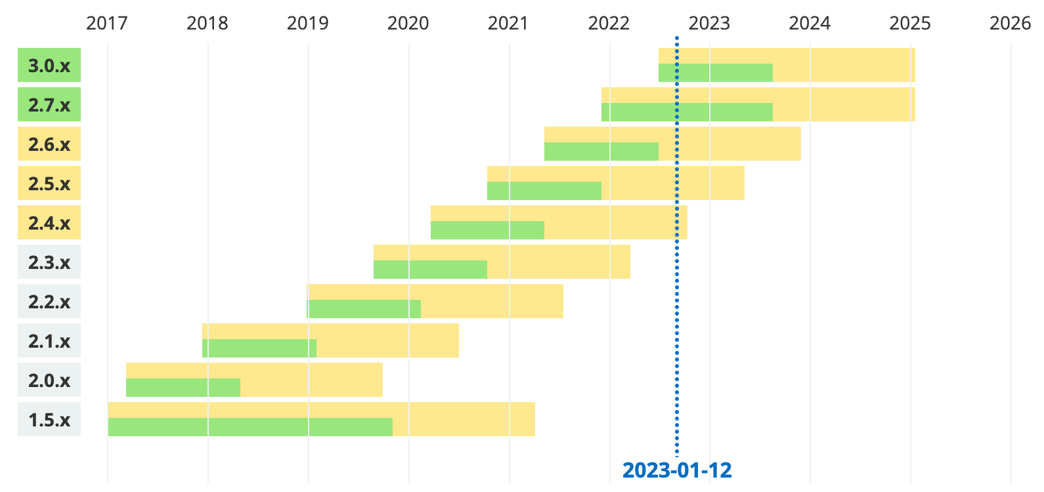
Commercial support for Spring Boot
Legend
 | OSS support |  | Commercial support |  | Future release
 | Free security updates and bugfixes with support from the Spring community. |  | Business support from Spring experts during the OSS timeline, plus extended support after OSS End-Of-Life. Publicly available releases for critical bugfixes and security issues when requested by customers. |  | Generation not yet released, timeline is subject to changes.

Slide 6

Why operators / platform teams will love Azure Spring Apps
Well architected workloads
Notes:
We just saw an introduction to Azure Spring Apps.
Let me give you more reasons to love this service.
When you choose to run your apps in the cloud, on a specific service, you also have to think about the rest of the ecosystem, the networking , etc.
Now, let me give a couple more reasons why to love this service:
We have compiled for you a list of best practices to help make your journey to the cloud successful.
We call this the Well Architected framework.

Slide 7
Well Architected Framework
Best practices to drive workload quality
Cost
Optimization
Operational Excellence
Performance Efficiency
Reliability
Security
Azure Hybrid Benefit
Reserve Instances
Shutdown
Resize
Move to PAAS
DevOps
Deployment
Monitor
Processes and cadence
Design for scaling
Monitor performance
Define requirements
Test with simulations and forced failovers
Deploy consistently
Monitor health
Respond to failure and disaster
Identity and access management
Infra protection
App security
Data encryption and sovereignty
Security operations
https://aka.ms/architecture/framework
Notes:
We have compiled a list of best practices to help you be successful at running your workloads.
We call this the Well Architected framework.
This is a set of recommendations that speaks to different teams at your organization, for example, your architects, your engineers, your security teams.
It is a set of recommendations around cost, security, performance and reliability and operational excellence.
We have a link on the screen, when you go there, you would find a ton of documentation, videos, assessments, and even deployment plans that follow these best practices.
But we didn’t stop there …
We also have a service, a complimentary service called Azure Advisor, built right into the Azure Portal.
The point of the service is to scan your deployed resources, and measure it against the Well architected framework,
Demo
Here is what it looks like:
You get this nice summary screen, letting you know about our findings.
Then you can deep dive into the different focus areas, and find out more and which resources are impacted.
We have categories for impact – high, medium, low – to help you prioritize your actions.
And you can also set up alerts for yourself, so you don’t have to constantly check this screen; we can have the recommendations come to you as they get added.
Again, this service is complimentary, you get this just being an Azure customer.
We also assign you a score, and give you some score history, so that can track progress and show your management, “Hey, look at what we did!”

Slide 8
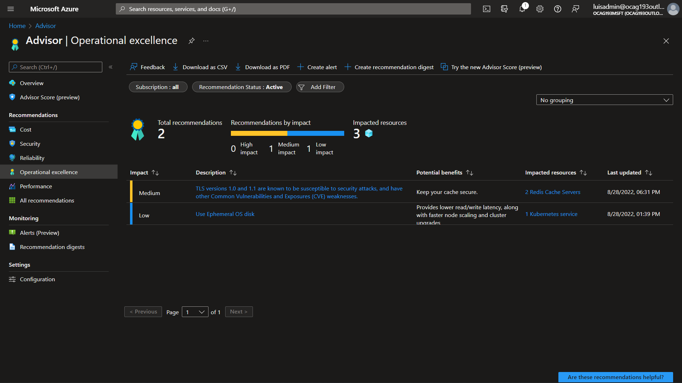

Slide 9
Hub & Spoke Architecture
Notes:
Separate networks:
Hub has central services.
Spokes have workloads.
Spokes cannot talk to each other directly.
Hub to spoke using virtual network peering (a native Azure service).
Management separation.
Cost savings in the hub.
Site-to-site VPN or Physical circuit to on-premises.
Route from on-premises and back from anywhere as allowed.
Next, let’s talk about the networking story …
The recommended network architecture in Azure is the Hub and Spoke architecture.
In this design, we separate virtual networks to separate management and centralize services:
In the hub, we deploy our networking services, firewalls, gateway, dns. It is managed by your network teams; others do not have access to manage these resources.
Then we have spoke virtual networks
On those networks, your application owners and developers deploy their application resources, and databases, virtual machines.
You can may spoke virtual networks, per workload, per team.
One key benefit is that these different spokes cannot route or talk to others directly, reducing your attack surface.
All traffic must go through the hub.
This gives you tight control over the flow of traffic.

Slide 10
Common scenarios
Publicly accessible application
App with on-premises data sources
Internal only
Line of business application
Industry compliance
App with compliance requirements
Notes:
Now let’s see how these concepts apply to some very common scenarios.
An internal-only application, such as a line of business application.
Internet-accessible app, but let’s make it more interesting. This app also needs to connect to on-premises resources.
Internet-accessible app that needs to meet regulatory compliance.
Let’s begin …

Slide 11

Internal / Line of business application
Fast, private connectivity options
Easy to set up Single Sign-on
Scale as needed
Notes:
Summary:
Fast connect from on-premises via vpn or circuit
Route via hub then spoke
Single sign-on
Spring apps access to other resources in the private network
You have deployed a line a of business app to Azure Spring Apps. For example, an employee portal or some type of time-tracking application:
Your users need to connect to this app over the private network, meaning, users at the office or perhaps working from home, but using VPN.
You connect your offices and datacenters to Azure using a site-to-site VPN or physical circuit. By the way, we call that physical circuit – express route, and you can go up to 100 Gigabits.
This app is meant for your employees, so we want to make sure we implement access control using their own corporate accounts, no need to have a second set of credentials.
Azure Spring Apps makes it simple to authenticate your users using single sign-on against your existing directories. You can then do things like require multi-factor authentication to protect those logins.
Your app can access other Azure-Native services like databases, storage accounts, over the private network, etc.
Internal line of business app. For example, some type of employee portal or time-tracking application:
Your employees can connect to the Azure Spring Apps service via the private network, no need to go over the internet.
Your corporate datacenters connect to Azure via a site-to-site VPN or a physical circuit, 2 very industry-standard options.
You can have multiple connections for high availability and from different geographic locations. And to meet your speed and latency requirements.
App does not expose endpoints to the internet.
So, it doesn’t matter if you need to provide service for 10 employees in 1 office, or hundreds of thousands of employees in offices across the globe, there are solutions for this.
In our hub network, we
Because this app is meant for your employees, we would want them to log in with their corporate credentials and not a second account.
Azure Spring Apps makes it possible to configure single sign-on against your existing directories.
And if you use Azure Active directory, you can easily require multi-factor authentication to protect those apps.

Slide 12
Public application with on-premises dependencies
Protect from common attacks
Reach back to on-premises resources
Multiple high availability options
Notes:
Summary
app is protected by WAF from common attacks
on prem reach back via VPN or ER
High availability options
Multiple instances
Across different geo areas (East coast / west coast)
Use a global dns load balancer to send users to the closest area.
In this scenario, we have an app that’s exposed to the big bad internet.
Perhaps this app is your customers or for partners.
For example, a billing and subscription management application.
You may notice we added a new component in the hub virtual network.
An application gateway, which is also a Web application firewall.
By doing this, we are instantly protecting your app from common attacks, such as SQL injection, cross site scripting, DDOS attacks, no code changes required.
We are also adding layer of security between your app and the internet. You could for example make it where only certain endpoints of the application are exposed, any other traffic does not make it back to your app.
Also, this application needs to reach back to your on premises network for some type of database or API, maybe a mainframe.
That site to site VPN or physical circuit is bi-directional.
So you can reach back to onprem and connect to the resources you need to.
And to make your app super resilient, you make it highly available.
High availability comes in multiple flavors
You can make Azure spring apps highly available within a single data center, but multiple racks.. Reach rack has its own power, cooling, networking setup
You can also make Azure spring apps highly available across multiple data centers, we call those Zones.
And in this case your app is resilient not only at the rack level, but also the data center level, protecting you from things like a “Fire at the data center”
Let me show how simple it is to make your apps highly available.

Slide 13
High availability options

Slide 14
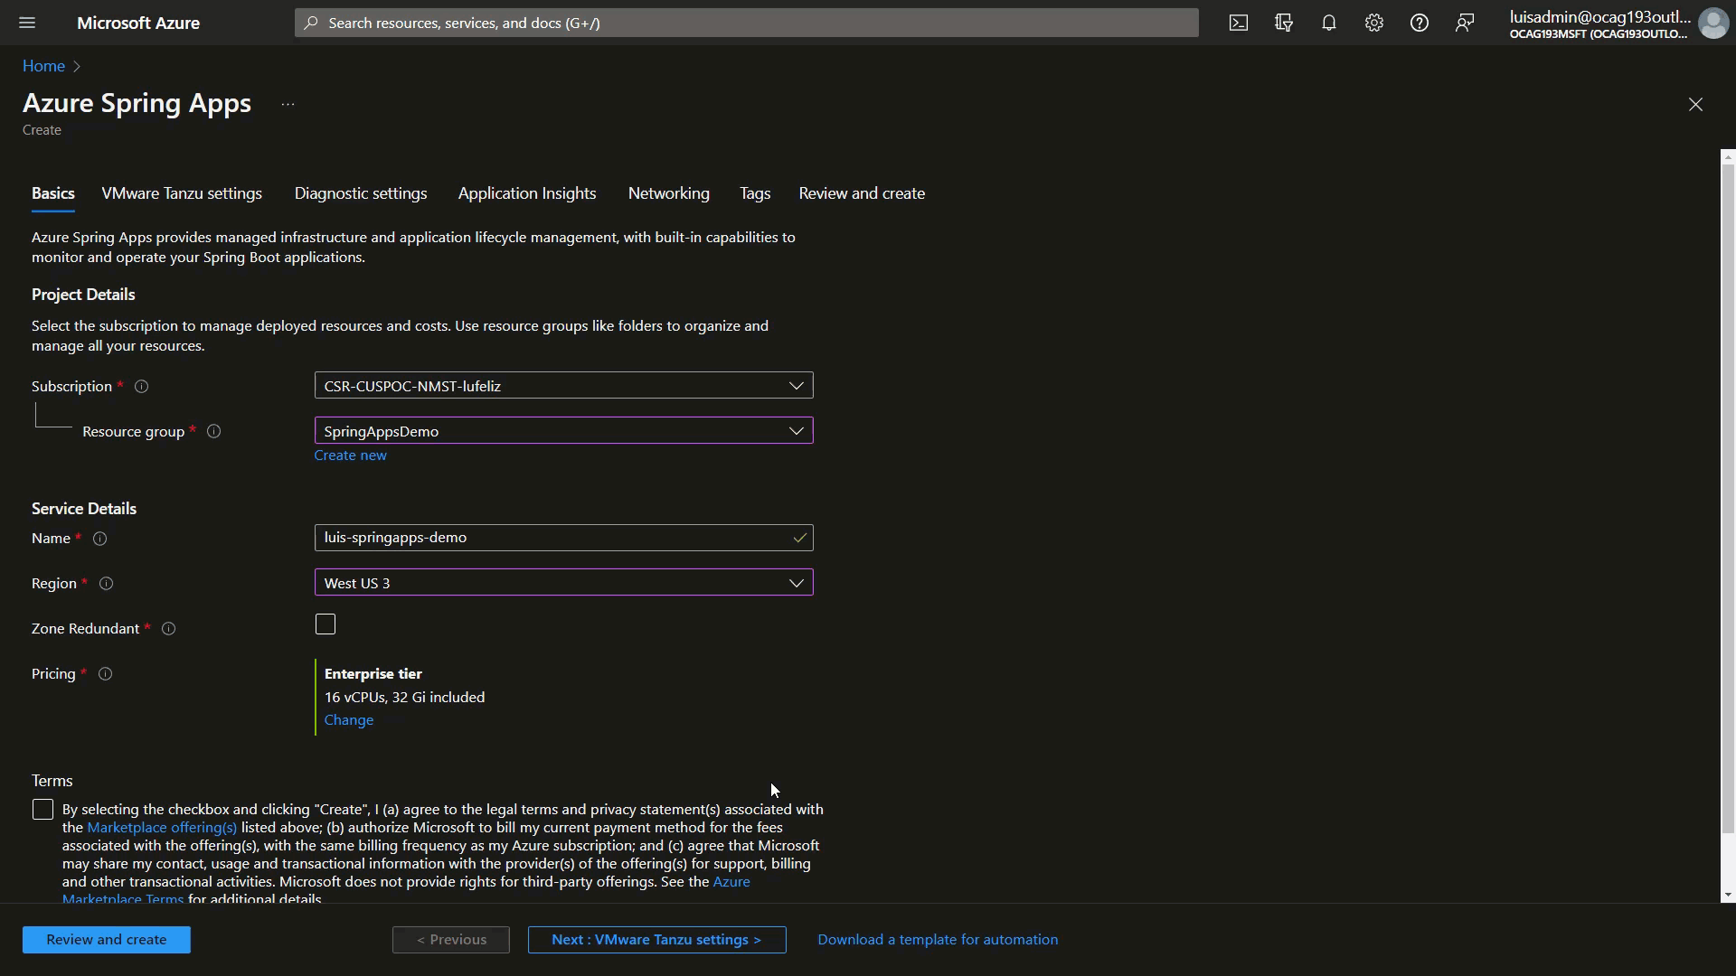
Notes:
High availability across 3 distinct datacenters, just a checkbox.

Slide 15
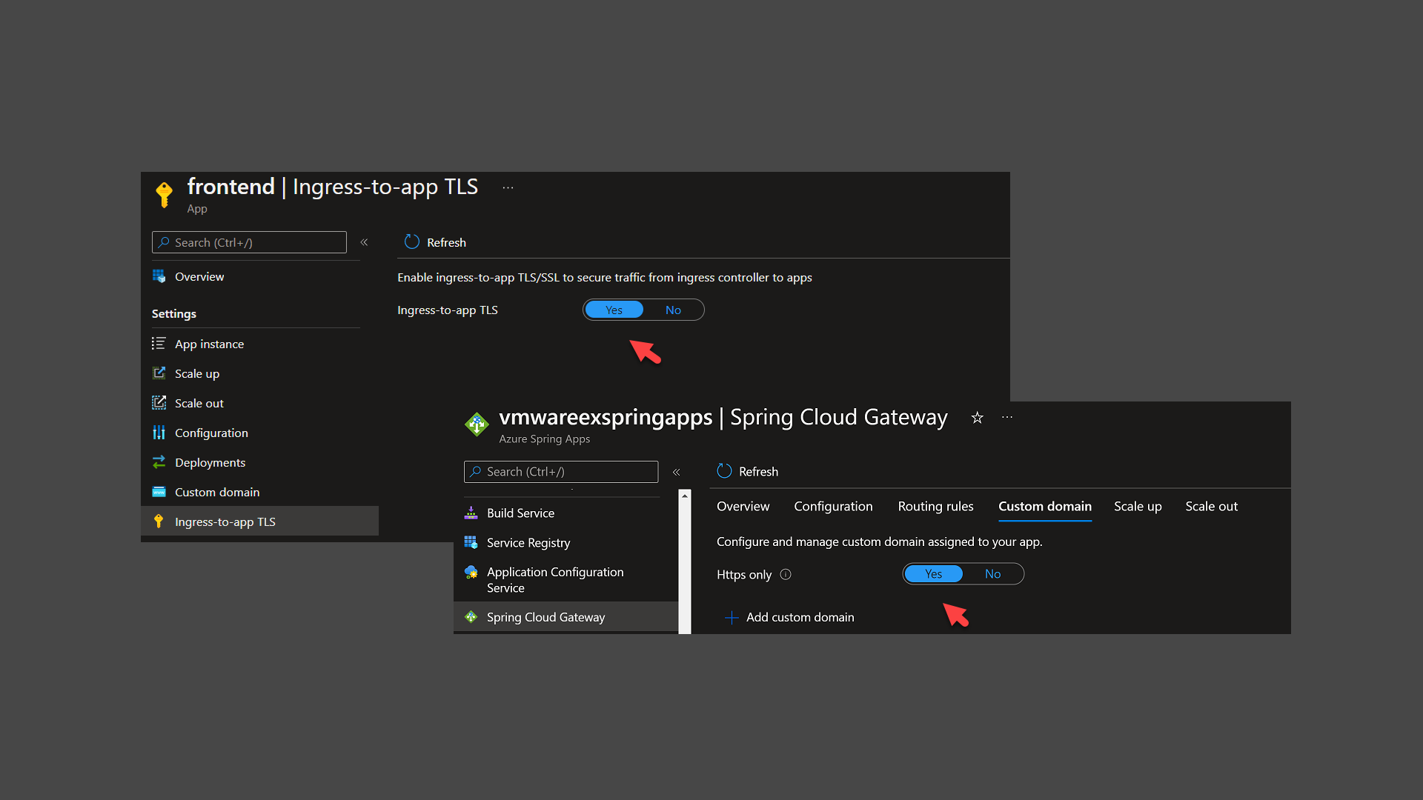
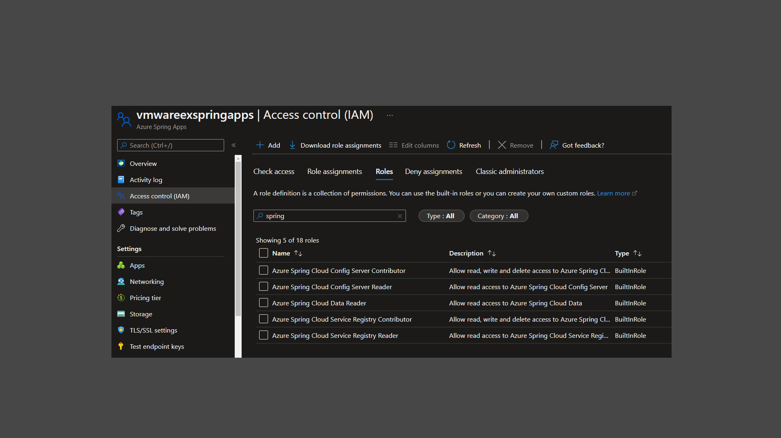
Regulatory Compliance (ex. PCI-DSS)
Access Control / Least privilege
Encrypt storage and network traffic
Control, log, inspect connections
HTTPS everywhere
Mutual TLS
Storage encryption
Database encryption
Notes:
Summary:
App is subject to regulations
Controls like “monitor and log every connection”, Data encryption, Data residency, Access control
NVA or Az Firewall to restrict, monitor, inspect and log all connections
Platform controls allow you to encrypt storage, databases, and network traffic
Azure Role based access control – fine grained least privilege scenarios
Deploy to your region of choice.
In this design, we take the same publicly accessible app, but it happens that this is for a regulated industry, or your processing regulated data, like PCI and payment information.
In this case you will have a number of requirements you need meet, like:
Logging and inspecting every connection back to the app.
For this design, we have added a firewall, which could be an Azure Firewall, or it could be a Network virtual appliance, by a vendor, of your choice, like Cisco, Palo Alto, Checkpoint, to name a few.
These services allow you to perform TLS inspection and control and monitor traffic.
Another requirement you may have is
Data encryption, while at rest or while in transit
The Azure platform by default encrypts all storage with Azure managed keys.
You can additionally encrypt storage accounts, and databases with your own private keys
There are also options to enforce TLS end to end, all the way from the user to the application, and then from the application to its back-end resources.
Lastly, you may also have requirements to lockdown administrative access as much as possible. Least privilege scenarios. This is all Achievable using Azure role-based access control, for any of your resources.
In summary, we have the services and features to help you meet your regulatory requirements.

Slide 16

Price reduction. Azure Spring Apps does more, costs less!
TIER | BASIC | STANDARD | ENTERPRISE
New Base Unit | 2 vCPU, 4 GB | 6 vCPU, 12 GB | 6 vCPU, 12 GB
New Base Price | No Changes | 70% of current price | 35% of current price
New Overage vCPU Price | 79% of current price | 79% of current price | 79% of current price
New Overage Memory Price | 85% of current price | 85% of current price | 85% of current price
VMware Tanzu Component License | -- | -- | No changes
Monthly Free Grant | 50 vCPU hours 100 Memory GB hours | 50 vCPU hours 100 Memory GB hours | 50 vCPU hours 100 Memory GB hours
Reductions effective Sep 1, 2022.
Monthly free grants effective mid-Sep 2022.
Approximated percentage changes are based on prices for the US East Region.
See Azure pricing page for actuals. Billing is based on usage.
©2022 VMware, Inc. and Microsoft Corporation. All rights reserved.
Notes:
© 2022 VMware Inc. and Microsoft Corporation. All rights reserved. MICROSOFT MAKES NO WARRANTIES, EXPRESS, IMPLIED OR STATUTORY, AS TO THE INFORMATION IN THIS PRESENTATION.

Slide 17
Accelerate Spring Apps to cloud at scale today!
Develop your first Spring Boot App
aka.ms/Start-Spring
Learn using a self-paced workshop
aka.ms/Learn-Spring
Watch demos
aka.ms/Spring-Playlist
Leverage best practices
aka.ms/Spring-Boot
Build and deploy Java apps on Azure
aka.ms/LearnJava
Interact with Azure services using Spring
aka.ms/Spring-Cloud-Azure
Notes:
Everyone watching today can build cloud solutions and advance them to production. We love to hear how you are building impactful solutions using Azure Spring Apps ..
You can get started today …
You can deploy your first Spring Boot app today.
You can also use a self-paced workshop to learn the details of the service
Prefer videos – we have great YouTube videos, follow the Spring playlist
You can also leverage best practices for deploying Spring Boot apps
You should let us know how you are building impactful solutions!

Slide 18
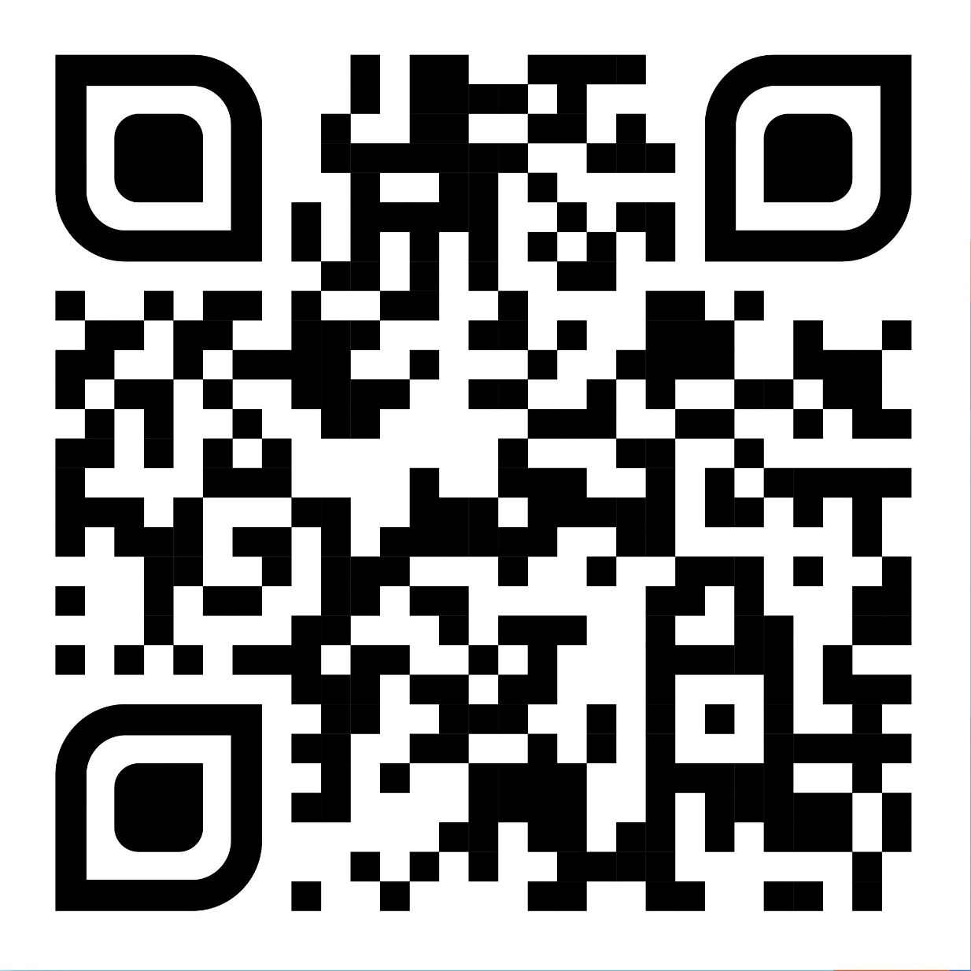
Start Enterprise!
Ship faster and unlock Spring’s full potential
aka.ms/spring-apps enterprise
Notes:
Start today – you can ship faster and unlock Spring’s full potential!
Thank you for joining us today. We are available here to answer your questions. Please share your questions. Thank you again

Slide 19
Sign up Rapid App Assessment Workshop

Slide 20
Socials and Networking!
Notes:
Speaker: Asir and Adib

